Slide 1



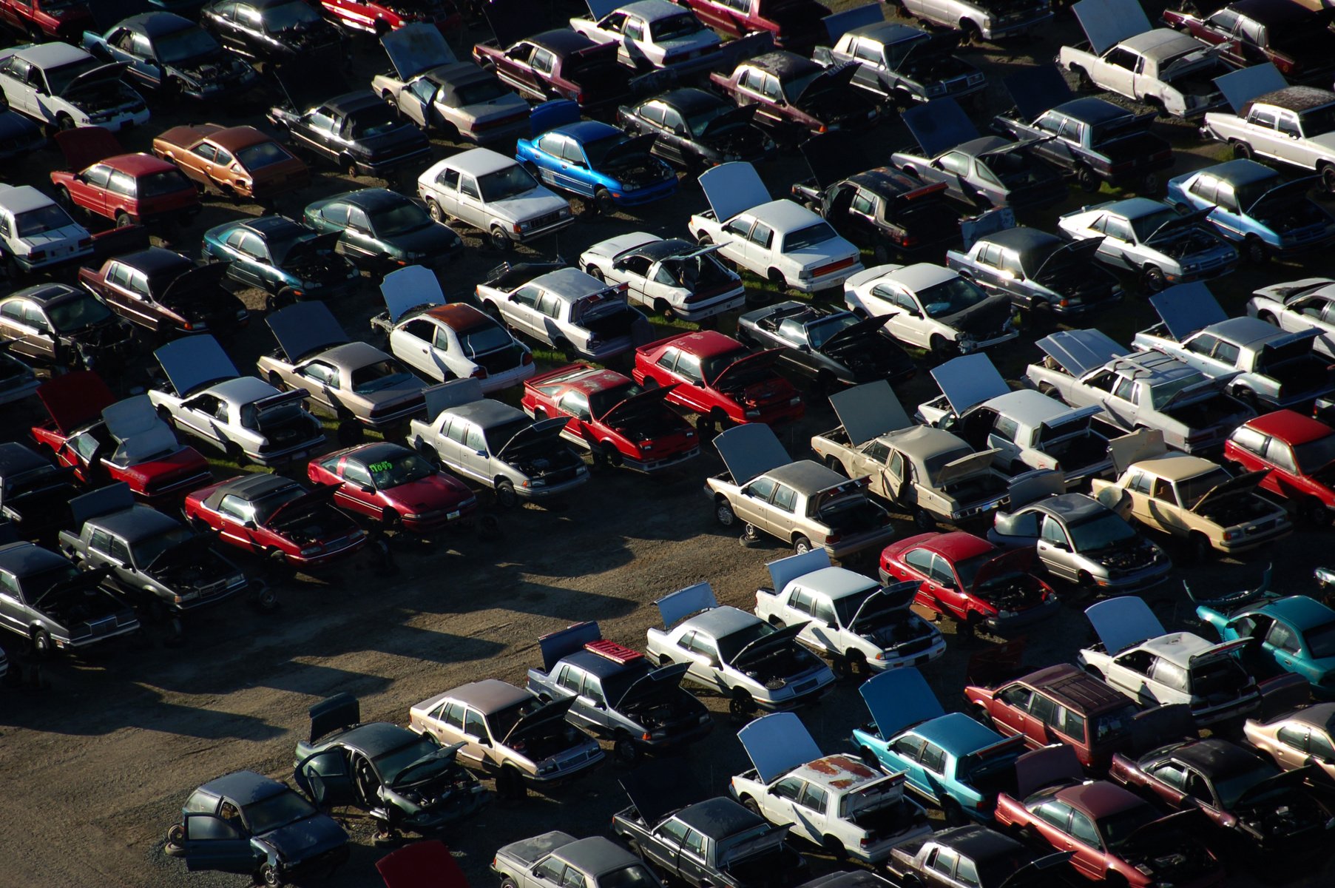


MARKET MAVERICKS
DISCOVERING INSIGHTS: USED CAR LANDSCAPE DATA ANALYSIS
KRISH DODHIA 22BTRAD019
ALOK SINGH 22BTRAD003
ABHINANDAN SINGH PARMAR 22BTRAD001

Slide 2


DATA CONTENT:
Dataset contains information on used cars from 13 manufacturers.
Transmission
Mileage
Engine size
Models
FuelType
Tax
Price
Years
mpg

Slide 3


APPROCH
Our approach focuses on showcasing the sustained quality of certain car manufacturers post-usage, emphasizing their ability to maintain excellent condition despite previous ownership.

Slide 4
DATA ANALYSIS EXCUTED
Transmission Analysis
Analyzing transmission types across all manufacturers
Fuel Analysis
Analyzing Fuel types across all manufacturers
Models Analysis
Analyzing Number of Models across all manufacturers
Max. Models Analysis
Analyzing Max. Models sold across all manufacturers
Acquired Analysis
Analyzing Numbers of Cars Sold across all manufacturers

Slide 5
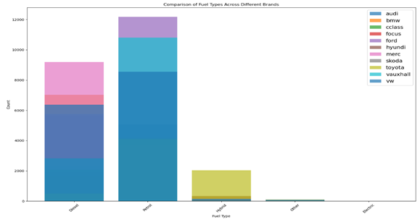
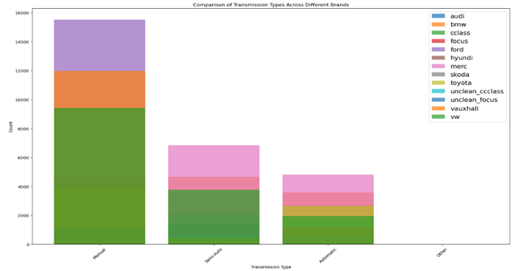
INFERENCES
USED CARS ANALYSIS
Transmission Analysis
In Manual : Ford have most number of Cars
Volkswagen have least number of Cars
In Semi auto : Merc have most number of Cars
Cclass have least number of Cars
In Automatic : Merc have most number of Cars
volkswagen have least number of Cars
Fuel Analysis
In Petrol : Audi has the highest count in petrol
VW have least number of Cars
In Diesel : Mercedes-Benz has the highest count in Diesel
BMW have least number of Cars
In Hybrid : Toyota has the highest count in Hybrid
Audi have least number of Cars

Slide 6
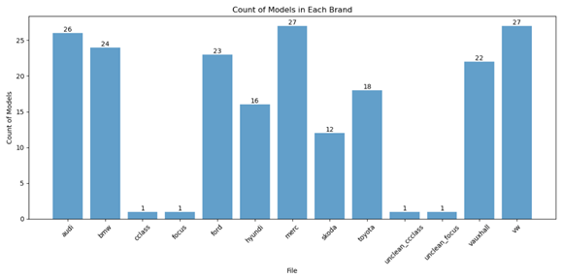
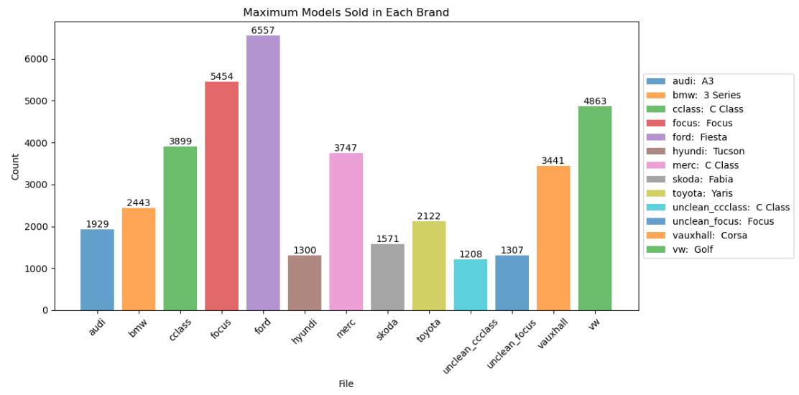
INFERENCES
USED CARS ANALYSIS
Max. Model Analysis
Ford has sold the most number of model,
with a count of 6557 across all manufacturers.
Hyundi has sold the least number of cars,
with a count of 1300 across all manufacturers.
Model Analysis
Merc and vw has most models
across all manufacturers.
c class , focus , unclean_cclass and
unclean_focus has most models
across all manufacturers.

Slide 7
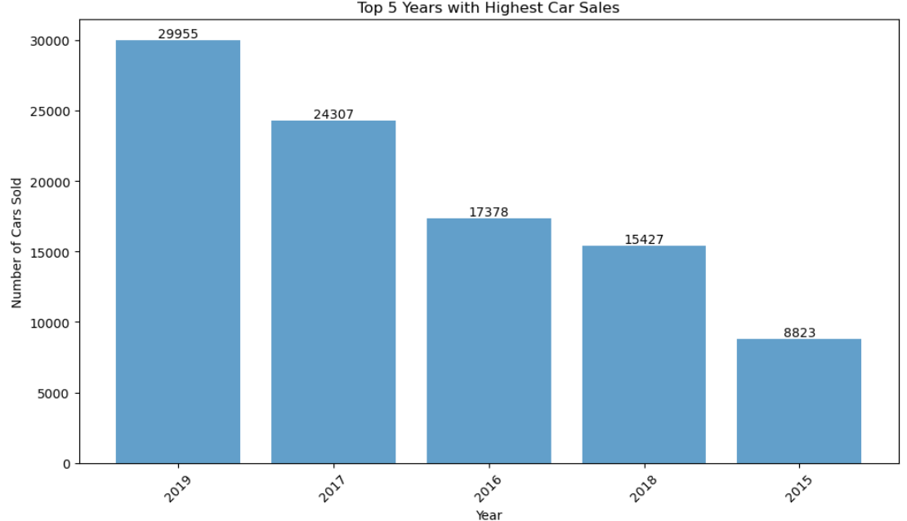
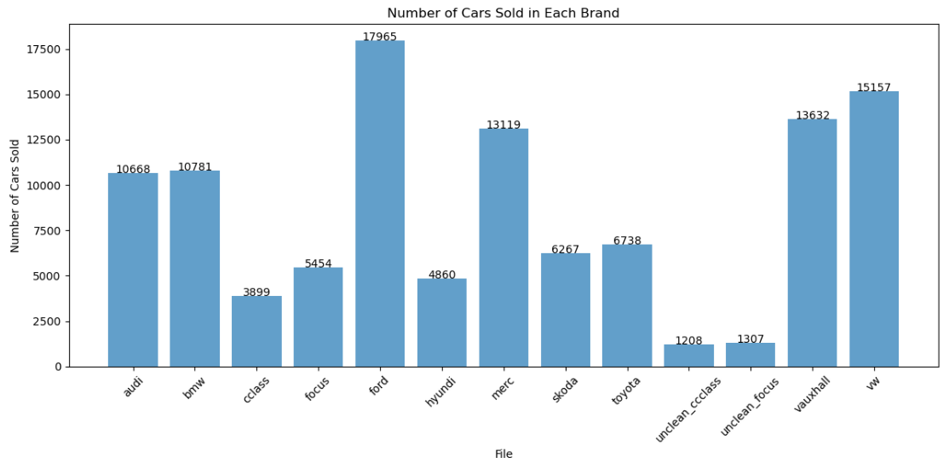
INFERENCES
USED CARS ANALYSIS
Acquired Analysis
Ford has sold the most number of cars,
with a count of 17965 across all manufacturers.
unclean_cclass has sold the most number of cars,
with a count of 17965 across all manufacturers.
TOP 5 YEAR WITH HIGHEST SALES
The year 2019 had the most car sales at nearly 30,000, followed by 2017 at nearly 25,000 cars sold.

Slide 8
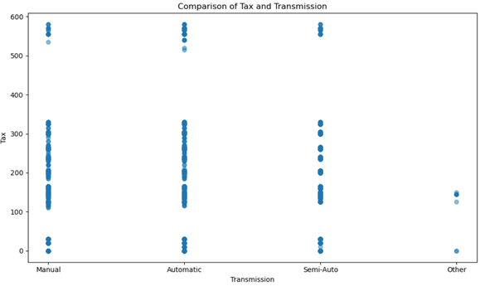
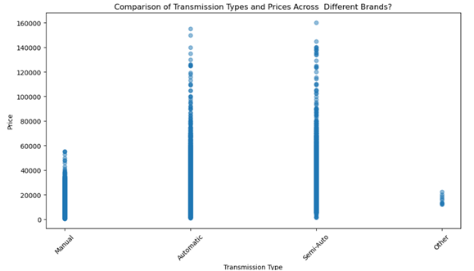
INFERENCES
USED CARS ANALYSIS
Comparision of Prices and Transmission
Automatic transmissions are generally the most expensive, followed by semi-automatic and manual transmissions. Other transmission types, likely less common ones, are the cheapest.
Comparision of Tax and Transmission
Cars with manual transmissions tend to have a lower tax rate than those with automatic, semi-automatic or other transmissions.

Slide 9
INFERENCES
USED CARS ANALYSIS
Worst Mileage Car:
model Q7
year 2019
price 69000
transmission Automatic
mileage 1
fuelType Diesel
tax 145
mpg 30.1
engineSize 4.0
Best Mileage Car:
model A6
year 2008
price 2490
transmission Manual
mileage 323000
fuelType Diesel
tax 200
mpg 44.1
engineSize 2.0
Highest Price Car:
model G Class
year 2020
price 159999
transmission Semi-Auto
mileage 1350
fuelType Petrol
tax 145
mpg 21.4
engineSize 4.0
Lowest Price Car:
model Astra
year 2001
price 450
transmission Manual
mileage 159000
fuelType Petrol
tax 235
mpg 40.4
engineSize 1.6

Slide 10
INFERENCES
USED CARS ANALYSIS
Highest Tax Car:
model R8
year 2014
price 59990
transmission Automatic
mileage 31930
fuelType Petrol
tax 580
mpg 21.9
engineSize 5.2
Lowest Tax Car:
model A1
year 2015
price 9500
transmission Automatic
mileage 54754
fuelType Diesel
tax 0
mpg 76.3
engineSize 1.6
Highest MPG Car:
model i3
year 2016
price 17100
transmission Automatic
mileage 25269
fuelType Other
tax 0
mpg 470.8
engineSize 0.6
Lowest MPG Car:
model Golf SV
year 2019
price 17950
transmission Manual
mileage 100
fuelType Petrol
tax 145
mpg 0.3
engineSize 1.0

Slide 11

Problem Faced
Merging both the datasets based on the required target variable
Fewer Related Columns
Choosing the Ideal Plot Type
The problem involves merging thirteen CSV files based on a common target variable, likely to combine related data from both files into a single dataset for analysis
There were columns which were not similar which lled to difficulty in mereging the column
Choosing the Best Type of Plot for Primary Data to Improve Understanding

Slide 12
Thank you!

